Slide 1
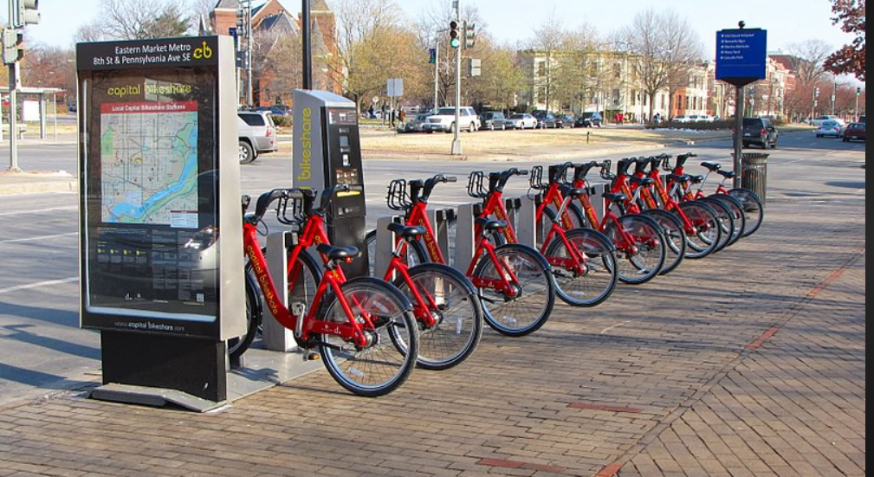


Capstone Project
Bike Sharing Demand Prediction
Rushikesh s Shete (rushishete101@gamil.com)
Notes:
Hello everyone my name is rushikesh shete today I am representing my first caps town project hotel booking analysis

Slide 2
Problem statement :
The contents of the data came from a city called Seoul. A bike-sharing system is a service in which bikes are made available for shared use to individuals on a short term basis for a price or free . The data had variables such as date, hour, temperature, humidity, wind-speed, visibility, dew point temperature, solar radiation, rainfall, snowfall, seasons, holiday, functioning day and rented bike count. The problem statement was to build a machine learning model that could predict the rented bikes count required for an hour, given other variables
Mobile Price Range Prediction
Data Summary
Cleaning of Dataset
Analysis & Visualization
Notes:
Hello everyone my name is rushikesh shete today I am representing my first caps town project hotel booking analysis

Slide 3
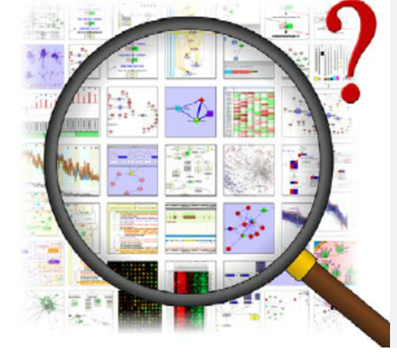
Points to discuss :
● Data description and summary ● Analysis of categorical variable ● Analysis of numerical variable ● Handling outliers ● Regression plot ● Machine learning algorithms ● conclusion
Notes:
Hello everyone my name is rushikesh shete today I am representing my first caps town project hotel booking analysis

Slide 4
Points to discuss :
The dataset contains weather information (Temperature, Humidity, Windspeed, Visibility, Dewpoint, Solar radiation, Snowfall, Rainfall), the number of bikes rented per hour and date information. ● Date : year-month-day ● Rented Bike count - Count of bikes rented at each hour ● Hour - Hour of he day ● Temperature-Temperature in Celsius ● Humidity - % ● Windspeed - m/s ● Visibility - 10m ● Dew point temperature – Celsius ● Solar radiation - MJ/m2 ● Rainfall - mm
Notes:
Hello everyone my name is rushikesh shete today I am representing my first caps town project hotel booking analysis

Slide 5
Points to discuss :
● Snowfall - cm ● Seasons - Winter, Spring, Summer, Autumn ● Holiday - Holiday/No holiday ● Functional Day – NoFunc (Non Functional Hours), Fun(Functional hours) 1. This dataset contains 8760 lines and 14 columns 2. Numerical variables - temperature, humidity , wind, visibility ,dew point temp, solar radiation,rainfall,snowfall 3. Categorical variables - seasons,holiday and functioning day 4. Rented bike column - which we need to predict for new observations
Notes:
Hello everyone my name is rushikesh shete today I am representing my first caps town project hotel booking analysis

Slide 6
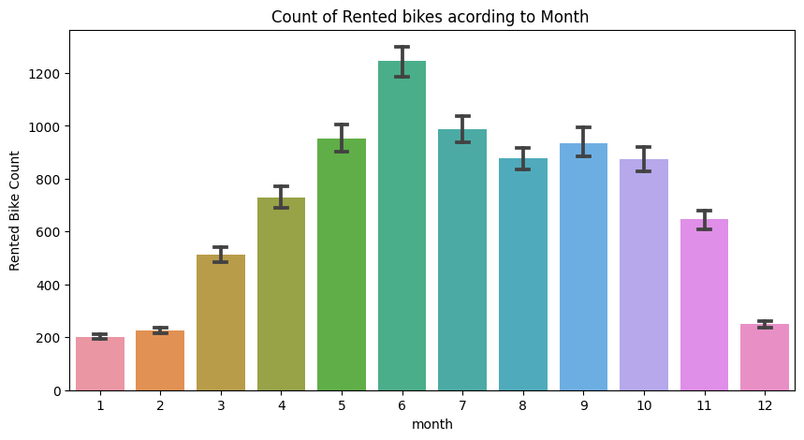
Data Visualization
Month
From the above bar plot we can clearly say that from the month 5 to 10 the demand of the rented bike is high as compare to other months
Notes:
Hello everyone my name is rushikesh shete today I am representing my first caps town project hotel booking analysis

Slide 7
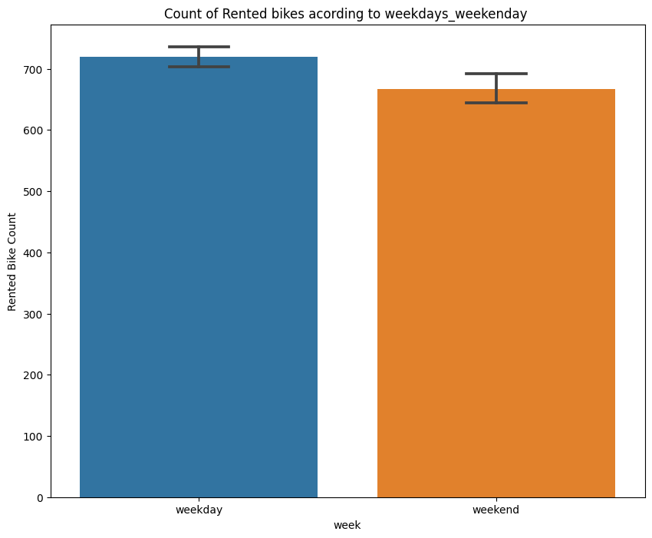
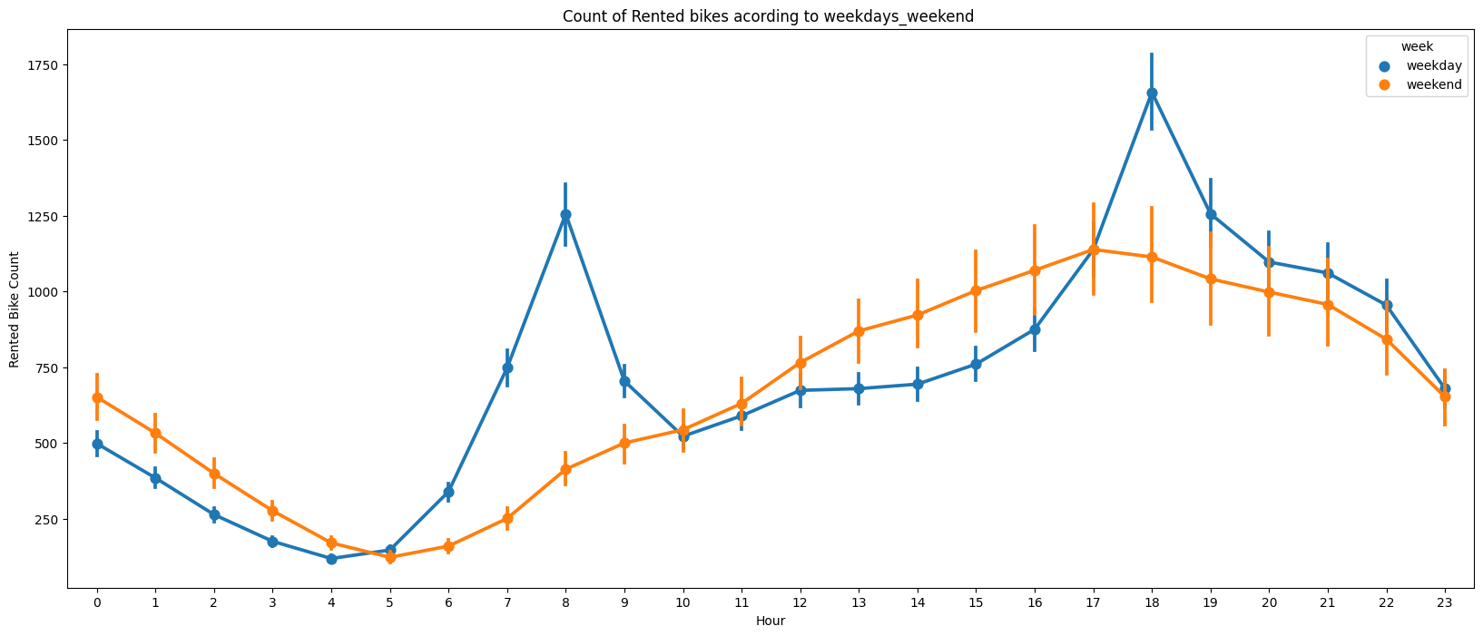
Data Visualization
week
From the above point plot and bar plot we can say that in the week days which represent in blue colur show that the demand of the bike higher because of the office. Peak Time are 7 am to 9 am and 5 pm to 7 pm The orange colour represent the weekend days, and it show that the demand of rented bikes are very low specially in the morning hour but when the evening start from 4 pm to 8 pm the demand slightly increases
Notes:
Hello everyone my name is rushikesh shete today I am representing my first caps town project hotel booking analysis

Slide 8
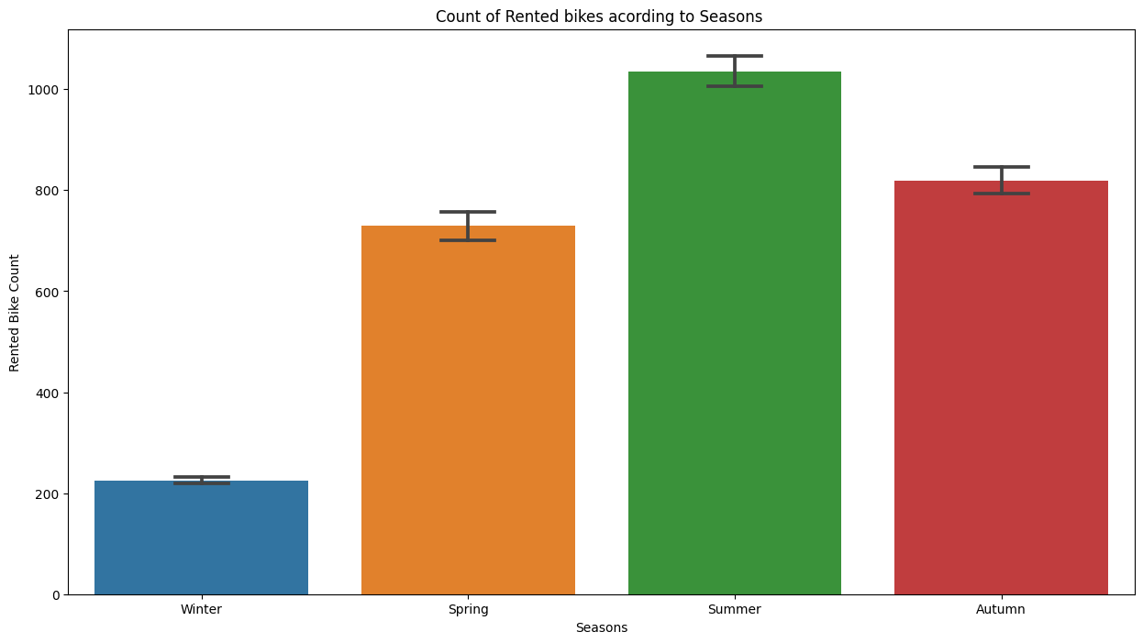
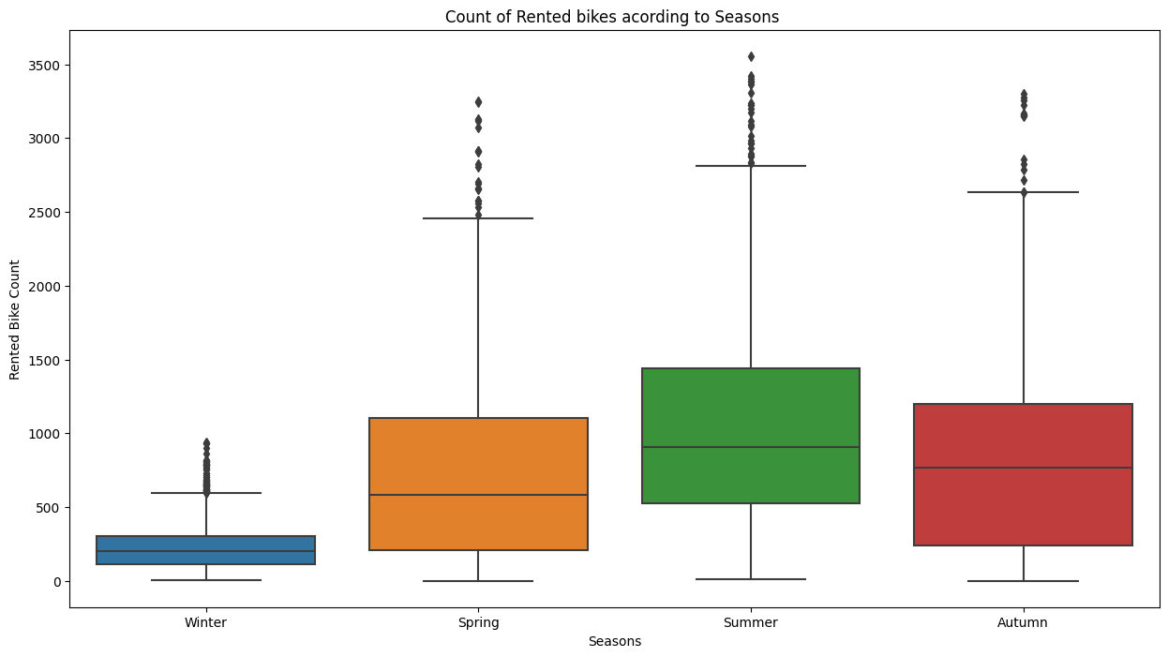
Data Visualization
seasons
In the above box plot and bar plot which shows the use of rented bike in in four different seasons, and it clearly shows that, In summer season the use of rented bike is high In winter season the use of rented bike is very low because of snowfall.
Notes:
Hello everyone my name is rushikesh shete today I am representing my first caps town project hotel booking analysis

Slide 9
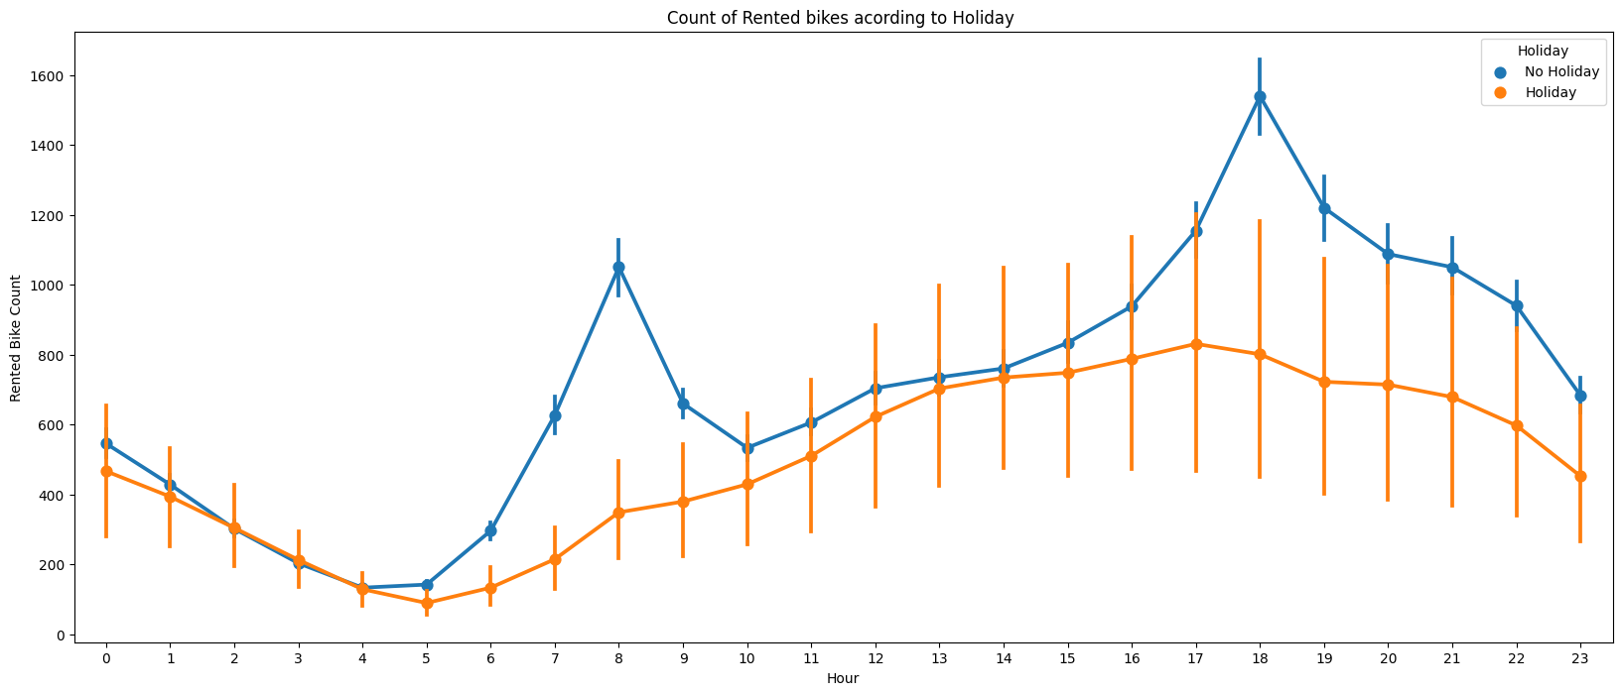
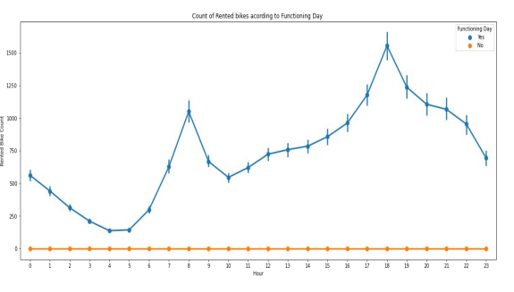
Data Visualization
Functioning day
Holiday
In the above point plot which shows the use of rented bike in a holiday, and it clearly shows that, plot shows that in holiday people uses the rented bike from 2pm-8pm
In the above point plot which shows the use of rented bike in functioning day or not, and it clearly shows that, Peoples dont use reneted bikes in no functioning day
Notes:
Hello everyone my name is rushikesh shete today I am representing my first caps town project hotel booking analysis

Slide 10
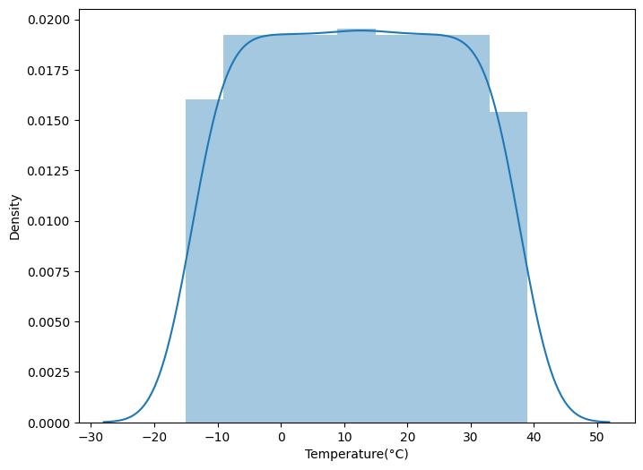
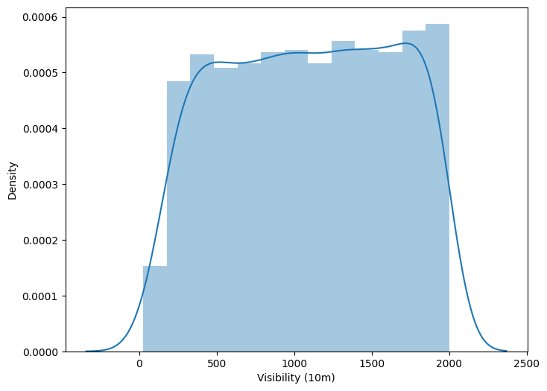
Data Visualization
Numerical variables Temperature
visibility
Above plot shows that people tend to rent bikes when the temperature is between -5 to 25 degrees.
Above plot shows that people tend to rent bikes when the visibility is between 300 to 1700
Notes:
Hello everyone my name is rushikesh shete today I am representing my first caps town project hotel booking analysis

Slide 11
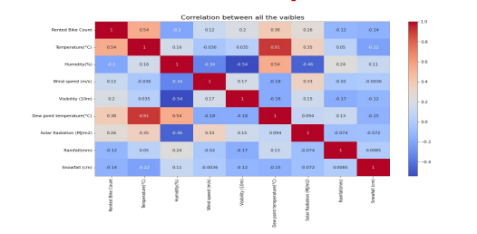
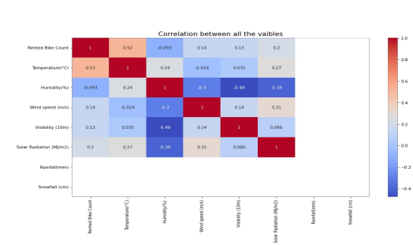
Data Visualization
Heat map
From the above heat map i can conclude that Temperature and Dew point temperature(°C) has the high correlation . we drop this column then it dont affects the outcome of our analysis
After removing the Dew point temperature
Notes:
Hello everyone my name is rushikesh shete today I am representing my first caps town project hotel booking analysis

Slide 12
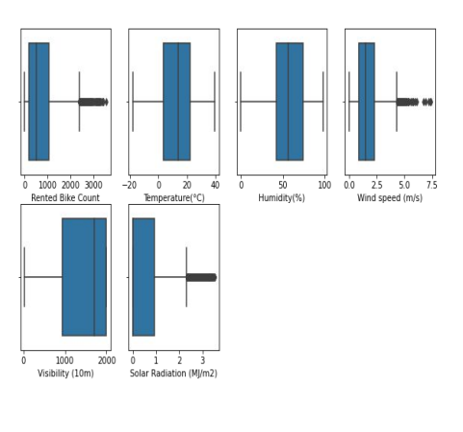
Data Visualization
Handling outliers
An Outlier is a data-item/object that deviates significantly from the rest of the (so-called normal)objects,The interquartile range (IQR) is the difference between the 75th and 25th percentile of the data. It is a measure of the dispersion similar to standard deviation or variance, but is much more robust against outlier
Notes:
Hello everyone my name is rushikesh shete today I am representing my first caps town project hotel booking analysis

Slide 13
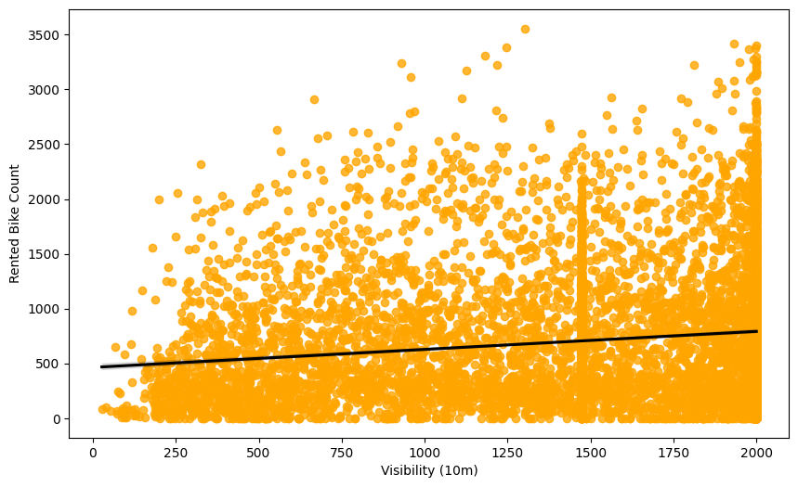
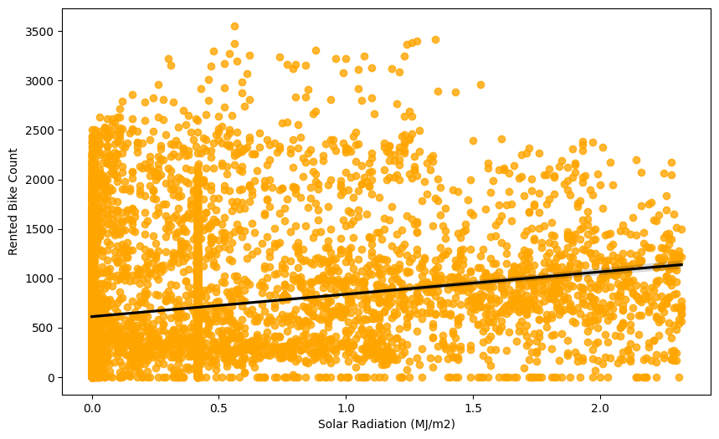
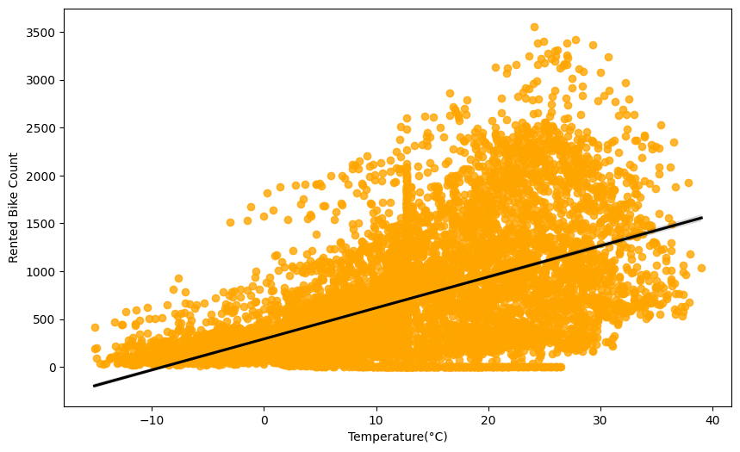
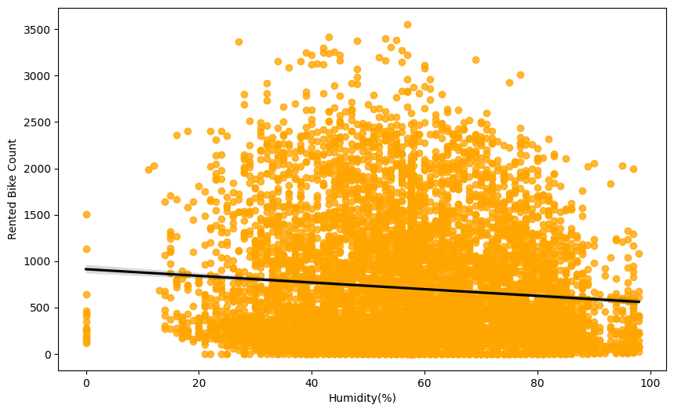
Data Visualization
Regression plot
Notes:
Hello everyone my name is rushikesh shete today I am representing my first caps town project hotel booking analysis

Slide 14
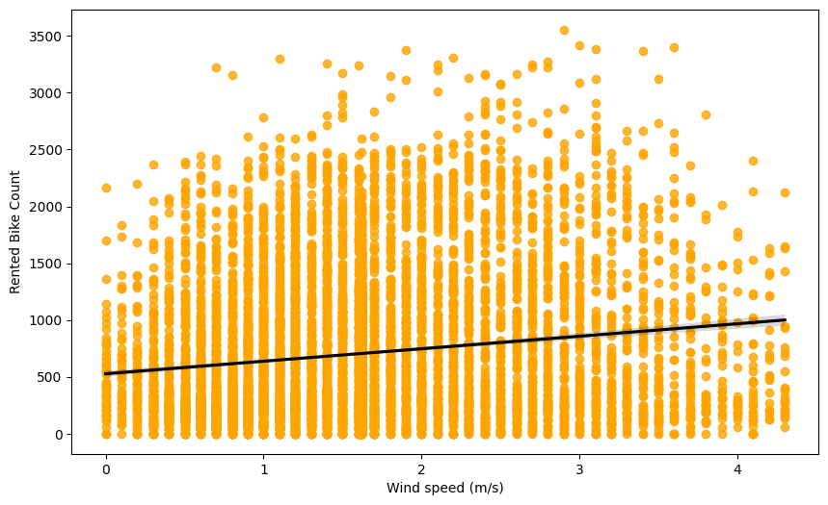
Data Visualization
● Temperature,solar radiation,wind speed,visibility are positively related to target variable ,the rented bike count increases with increase of these features
Notes:
Hello everyone my name is rushikesh shete today I am representing my first caps town project hotel booking analysis

Slide 15
ML algorithms
1. Linear regression 2. Ridge regression 3. Elastic net 4. Decision tree 5. Random Forest regressor 6. SVR 7. Gradient boosting
Notes:
Hello everyone my name is rushikesh shete today I am representing my first caps town project hotel booking analysis

Slide 16
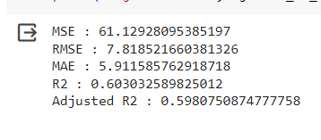
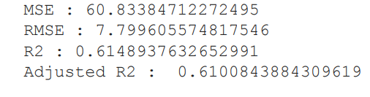
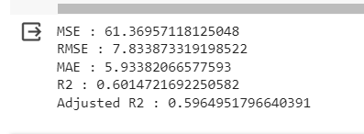
ML algorithms
● Linear regression
● Ridge regularization
● linear regression with elastic net
Notes:
Hello everyone my name is rushikesh shete today I am representing my first caps town project hotel booking analysis

Slide 17
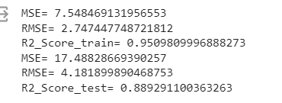
ML algorithms
● Decision tree
● Random Forest Regressor with GridSearchCV
The r2 score of decision tree is 0.8358437405936819 the r2 score of decision tree with hyper perameteres tunning is 0.8480124553969512
Notes:
Hello everyone my name is rushikesh shete today I am representing my first caps town project hotel booking analysis

Slide 18
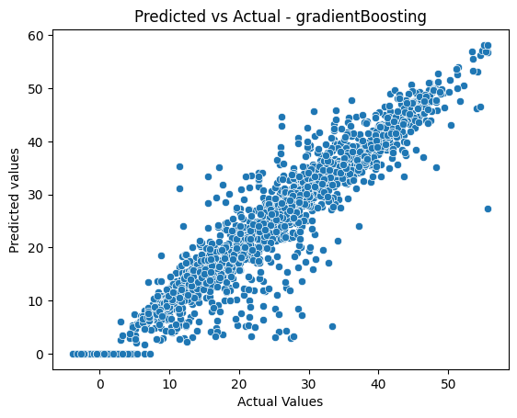



ML algorithms
● SVR using grid search cv
● Gradient Boosting Regressor with GridSearchCV
Notes:
Hello everyone my name is rushikesh shete today I am representing my first caps town project hotel booking analysis

Slide 19


Conclusions :
● Hour of the day holds most importance among all the features for prediction of dataset ● It is observed that highest number bike rentals counts in Autumn/fall Summer Seasons and the lowest in Spring season. ● We observed that the highest number of bike rentals on a clear day and the lowest on a snowy or rainy day ● the top 5 important features of our dataset are: Season_winter, Temperature, Hour, Season_autumn, Humidity ● Peoples dont use rented bikes in no functioning day ● people tend to rent bikes when the temperature is between -5 to 25 degrees ● people tend to rent bikes when the visibility is between 300 to 1700 ● for all the above experiments we can conclude that gradient boosting and random forest regressor with using hyperparameters we got the best results
You have successfully completed your Machine Learning Capstone Project !!!
Notes:
Hello everyone my name is rushikesh shete today I am representing my first caps town project hotel booking analysis

Slide 20

You have successfully completed your Machine Learning Capstone Project !!!
Notes:
Hello everyone my name is rushikesh shete today I am representing my first caps town project hotel booking analysis

